Slide 1

Market Research

Slide 2
Objectives of Lecture on Market Research
This lecture should lead you to an understanding of the uses and abuses of market research. If, in the future, there is talk of commissioning market research for an NPD project (or other research you may be working on) you should be able to:
  - evaluate the usefulness (or otherwise) of market research for the problem you are involved with
  - discuss appropriate types of research with confidence
  - set yourself realistic expectations regarding the results/ timing

Slide 3
“It is a capital mistake to theorise before one has data”
Sir Arthur Conan Doyle

Slide 4

Research on Agatha Christie
HarperCollins found sales of Agatha Christie
novels declining in 1985
Quantitative & qualitative research commissioned
Readers liked “niceness” of the crimes,
but covers were gruesome and bloody
Result: new cover designs commissioned
and in the first year sales rose 40%

Slide 5

Research at N.Brown
High rate of returns in 1993
Manchester University paid £100k to research women’s sizes
50,000 measurements taken
Women have “thicker waists, lower busts and conical figures”
Shape of clothes was changed
Returns down to 27% (vs industry average of 35%)

Slide 6
Structure of Market Research Lecture
Spend on Market Research
Types of Market Research
Potential Problems

Slide 7
Market Research vs Marketing Research
(strictly speaking...)
Market Research Researching the immediate competitive environment of the marketplace, including customers, competitors, suppliers, distributors and retailers
Marketing Research Includes all the above plus:
        - companies and their strategies for products and markets
        - the wider environment within which the firm operates (e.g. political, social, etc)

Slide 8
Market(ing) Research: Definition
The systematic design, collection, analysis and reporting of data and findings relevant to a specific marketing situation facing the organisation

Slide 9
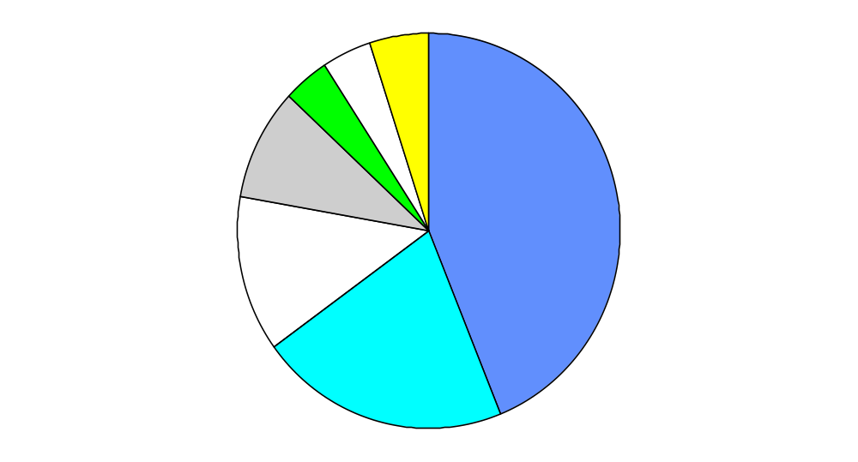
Spending on Market Research by Sector in the UK
Other
Non-ad. research agencies
Ad. agencies
5%
4%
4%
Retailers and wholesalers
9%
Manufacturing Companies
44%
13%
Public sector
21%
Service companies

Slide 10

The Ten Most Common Market Research Activities
Directly relevant to NPD
Activity
Percentage of companies doing activity*
Determination of market characteristics
97
Measurement of market potential
97
Market share analysis
97
Sales analysis
92
Studies of business trends
91
Short range forecasting
89
Competitive product studies
87
Long range forecasting
87
Pricing studies
83
Testing existing products
80
* based on research activities of 599 companies in the US

Slide 11
Top 10 market research activities
Market Measurement | 18%
New Product development/concept testing | 14%
Ad or brand awareness monitoring/tracking | 13%
Customer Satisfaction (inc Mystery Shopping) | 10%
Usage and Attitude Studies | 7%
Media Research & evaluation | 6%
Advertising developing and pre-testing | 5%
Social Surveys for central/local government | 4%
Brand/corporate reputation | 4%
Omnibus Studies | 3%
Source: BMRA

Slide 12
Market Research Budgets
1 - 2% of company sales = total budget
of this:
50% - 80% in-house
20% - 50% externally
85% of Fortune 500 companies have internal departments
1. Syndicated - service research firms
2. Custom research firms
3. Specialty research firms

Slide 13
External Market Research Firms
  Types Description
1. Syndicated - service research firms
Data gathered periodically from customers and distribution channels and then sold to clients (e.g. A.C. Nielson)
2. Custom market research firms
Hired to carry out specific research projects for clients. The firm conducts the survey and the results are the property of one client only (e.g. Research International)
3. Specialty line research firms
Firms providing a specialised service to other market research firms, e.g. a firm selling field interviewing services (e.g. Continental Research)

Slide 14
Why Conduct Market Research in New Product Development?
    - The product must appeal to the customer (however widely defined)
    - Timely market research can help you mould the product to the consumer’s need/wants
    - Market research tend to point out successes and failures before products are launched “for real”
    - As a result, it can save you money and time

Slide 15
WARNING!
Market Research is about understanding consumer reactions to the product. Marketing may understand the consumer best but R&D may well (early on) understand the product best
Don’t simply hand M.R. over to marketing!

Slide 16
Types of Market Research
By Source
- Primary
- Secondary
By Methodology
- Qualitative
- Quantitative
By Objectives
- Exploratory
- Descriptive
- Causal
(or experimental)

Slide 17
Types of Market Research: By Source
Primary Collection of data specifically for the problem or project in hand
Secondary Based on data previously collected for purposes other than the research in hand (e.g. published articles, government stats, etc)

Slide 18
Types of Market Research: By Methodology
Qualitative Quantitative
Type of Question Probing Simple
Sample Size Small Large
Information per respondent High Low(ish)
Questioner’s skill High Low(ish)
Analyst’s skill High High
Type of analysis Subjective, Objective,
Interpretative Statistical
Ability to replicate Low High
Areas probed Attitudes Choices
        Feelings Frequency
        Motivations Demographics

Slide 19
Benefits of Qualitative Market Research vs Quantitative
Benefit Comment/Example
Cheaper
Smaller sample size
Probes in-depth motivations and feelings
Allows managers to observe (through one way mirror) ‘real’ consumer reaction to the issue - e.g. comments and associations (e.g. Levis) regarding a new product fresh from the labs
Often useful precursor to quantitative research
Gives the research department a low cost and timely sense of which issues to probe in quantitative research

Slide 20
Qualitative vs Quantitative
Total
Mkt
Share
Quant
Qual
Market Measurement | 18.4% | 20.8% | 3.3%
NPD/Concept testing | 13.8% | 11.6% | 27.3%
Ad/brand awareness tracking | 12.7% | 14.4% | 2.2%
Customer satisfaction (incl mystery shopping) | 9.7% | 10.4% | 5.4%
Usage and attitude surveys | 6.6% | 6.0% | 10.4%
Source BMRA,

Slide 21
Types of Market Research: By Objective
Exploratory Preliminary data needed to develop an idea further. Eg outline concepts, gather insights, formulate hypotheses
Descriptive Describe an element of an ideas precisely. Eg who is the target market, how large is it, how will it develop
Causal Test a cause and effect relationship, e.g. price elasticity. Done through experiment

Slide 22
The Market Research Process
1. Defining the problem and objectives
2. Developing the research plan
3. Collecting the information
4. Analysing the information
5. Presenting the findings
Steps
Distinguish between the research type needed e.g.
- exploratory
- descriptive
- causal
Decide on
- budget
- data sources
- research approaches
- research instruments
- sampling plan
- contact methods
Information is collected according to the plan (N.B. it is often done by external firms)
Statistical manipulation of the data collected (e.g. regression) or subjective analysis of focus groups
Overall conclusions to be presented rather than overwhelming statistical methodologies
Comments
If a problem is vaguely defined, the results can have little bearing on the key issues
The plan needs to be decided upfront but flexible enough to incorporate changes/ iterations
This phase is the most costly and the most liable to error
Significant difference in type of analysis according to whether market research is quantitative or qualitative
Can take various forms:
- oral presentation
- written conclusions supported by analysis
- data tables

Slide 23
Potential Problems with Market Research
1. When and how not to do it
2. Problems with research buyers vs suppliers
3. Frequent technical pitfalls
4. Problems with traditional market research

Slide 24
When and How Not to Conduct Market Research
Lack of resources
Closed mindset
Research results not actionable
Poor timing re: marketplace
Late timing re: process
Vague objectives
Cost outweighs benefit

Slide 25
When and How Not to Conduct Market Research
    Occasion Comments/Example
Lack of resources
If quantitative research is needed, it is not worth doing unless a statistically significant sample can be used
Research results not actionable
Where psychographic data (for example) is used which won’t help the company form firm actions
Closed mindset
When research is used only as a rubber stamp of a preconceived idea
Late timing re: process
When research results come too late to influence the decision
Poor timing re: marketplace
If a product is in the ‘decline’ phase (e.g. records) there’s little point in researching new product varieties
Vague objectives
Market research cannot be helpful unless it is probing a particular issue
Cost outweighs benefit
The expected value of the information should outweigh the cost of gathering the data

Slide 26
Cost/Benefit of Market Research: ‘Rule of Thumb’ matrix
C = Cost
B = Benefit
B>C (?)
B>C
Large
(e.g. new brand of frozen fish)
(e.g. High Definition T.V.)
Market Size
C>B
B>C (?)
Small
(e.g. replacement screw for spectacles)
(e.g. computer aided metal stamping machines)
Low
High
Expected Profit Margin

Slide 27
Problems With Research Buyers vs Suppliers
Buyer
Narrow concept of research
Research used tokenistically
Unrealistic view of timeframe
Suppliers
Variable quality of market researchers
Market researchers not sufficiently demanding
Technical problems

Slide 28
Problems With Research Buyers vs Suppliers - Detail
Problems with Buyer of Research
Problems with Supplier of Research
- Narrow concept of research
  many managers see M.R. as no more than fact-finding
  they therefore spend little time defining the problem or explaining the context
  the results are irrelevant
  a vicious circle arises
- Variable quality of market researchers
  little uniformity of professionalism across the industry
  many small, poorly qualified companies
- Market researchers are not sufficiently demanding
  upfront time often insufficient
  little contact throughout process
- Research used tokenistically
  used to confirm existing views rather than objective look at marketplace
- Technical problems arise e.g.
  problem ill-defined
  questionnaires poorly constructed
- Unrealistic view of time frames
  often results are expected very rapidly
  research therefore commissioned too late
  research firms bow to time pressure and results are sub-optimal
Differing styles
M.R. documents are often phrased in an abstract, tentative way (and rely on jargon) whilst managers expect concrete, down to earth recommendations

Slide 29
Problems with Supplier of Research
Variable quality of market researchers
  little uniformity of professionalism across the industry
  many small, poorly qualified companies
Market researchers are not sufficiently demanding
  upfront time often insufficient
  little contact throughout process
Technical problems arise e.g.
  problem ill-defined
  questionnaires poorly constructed

Slide 30
Frequent Technical Pitfalls
1. Poor definition of problem
2. Designing the questionnaire
3. Sample size small
4. Data collection inadequate

Slide 31
Issues to consider in questionnaire design
Sensitivity of question
Bias in formulation
Cultural issues
Repetition
Respondent motivation
Questioner training
Pre-testing
Comprehensiveness
Realism
Ease of completion

Slide 32
Sample Airline Questionnaire
1. What is your total income to the nearest hundred pounds?
2. Are you an occasional or frequent flyer?
3. Do you like this airline?
4. How many airline ads did you see last spring compared to this spring?
5. What are the most salient and determinant attributes in your evaluation of airlines?
6. Do you think it is right for the government to tax air tickets and deprive a lot of people of the chance to fly?

Slide 33
Dodgy Questions: Airline Example
    Questions Objections
1. What is your total income to the nearest hundred pounds?
- the respondent probably doesn’t know the answer with this degree of accuracy
- the firm doesn’t need to know the answer with this degree of accuracy
- people are not keen to reveal income that accurately
- a questionnaire should never begin with such a personal question
2. Are you an occasional or frequent flyer?
- how do you define occasional versus frequent: everyone will define it differently
3. Do you like this airline?
- ‘like’ is a relative term
- will people answer it honestly when phrased so blatantly?

Slide 34
Dodgy Questions: Airline Example - cont’d
    Questions Objections
4. How many airline ads did you see last spring compared to this spring?
- Who can remember?
- What do you call ‘spring’?
- What is an ad? Is it TV, magazine, poster or what?
5. What are the most salient and determinant attributes in your evaluation of airlines?
- What’s meant by ‘salient’ and ‘determinant’?
- This sounds pompous and arrogant even if people do understand
6. Do you think it is right for the government to tax air tickets and deprive a lot of people of the chance to fly?
- All objectivity is out of the window
- Why ask if you’ve already made your mind up of the effects?

Slide 35
Problems with Traditional Market Research
1. Market research has allowed prominent product failures, and wrong predictions
2. Markets are increasingly becoming micro-segmented (e.g. sports shoes aimed at affluent fashion conscious women specifically for aerobics), so mass market research becomes correspondingly irrelevant
3. It is helpful for improvements, but less so for radical innovations
4. For more accurate targeting it may be advantageous to work with leading customers within the target group

Slide 36
Careful how you ask the question
Q. Do you approve of smoking whilst praying?
A: No
Q. Do you approve of praying whilst smoking?
A:Yes

Slide 37
Market Research Failures: The 1992 Election
Polls Prediction on eve of election = 1 point Labour lead
Actual election result = 8 point Tory lead
Reasons*
- Late swing to Tories (maybe accounts for 1/4 of error)
- Inadequate weighting of results to incorporate:
  Tory voters’ reluctance to reveal intentions
  “Spiral of silence” - reluctance to go against the fashion
- Poor sampling methods
Now:
- Adjusted polls “weight” results
- Some polls done by secret ballot
* according to inquiry chaired by David Butler, Professor of Economics

Slide 38
Coca Cola Failure: Chronology
May 1985 Old Coke withdrawn
        New Coke introduced
July Old Coke reintroduced as Coke Classic

Slide 39
Coca Cola Failure: Background and Research
- Early 80s, share losses to Pepsi
- New Product research carried out
  $4m cost
  200,000 taste tests
  60% of consumers preferred it in blind tests
- BUT research was narrowly defined
  considered taste not emotions
  dropping Old Coke not mentioned

Slide 40
U.S. Reaction to Old Coke’s Return
Political
Senator David Prior of Arkansas on the Senate Floor:
“A very meaningful moment in the history of America, this shows that some national institutions cannot be changed”
ABC interrupted its soap opera, General Hospital on Wednesday afternoon to break the news
Coca Cola’s share price rose to its highest level in 12 years
Media
Economic

Slide 41
Limited Use of Market Research
“Formal market analyses continue to be useful for extending product lines, but they are often misleading when applied to radical innovations. Market studies predicted that Intel’s microprocessor would never sell more than 10% as many units as there were minicomputers, and that Sony’s transistor radios and miniature TV sets would fail in the marketplace.
At the same time, many essential failures such as Ford’s Edsel and supersonic transport were studied and planned exhaustively on paper, but lost contact with the customers’ real needs.
        Source: James Brian Quinn

Slide 42
New Market Research
Traditional Market Research
Reliance on lead customers
interactive development
increasingly popular (3M, HP, Sony, Raychem)
Better for true innovations

Slide 43
Large Company Reliance on Customer’s Views
  What Why Who How
Many experienced large companies are relying more on interactive development with lead customers
Traditional market research for truly innovative new products has frequently proved misleading
3M
Hewlett-Packard
Sony
Raychem
Radically new products introduced by small teams working closely with lead customers (e.g. retailers). With this info. designs rapidly modified and interactive changes made

Slide 44
Market Research: Summary
1. Market Research is usually an integral part of understanding innovations - you ignore it at your peril....
2. But it must be timely, objective and relevant, otherwise it is worse than useless, leading you down the wrong path
3. So, be involved as far as you can be, especially up front and don’t let the jargon deter you!

